Slide 1
Tableau Project: Bookstore Performance & Publisher Insights (Q1 2024)
Robert Bejenaru – Data analyst career program

Slide 2
Project Brief
Overview:
I am working as a Junior Data Analyst for a national bookstore group that sells books across several U.S. regions. Management has asked for a Q1 2024 performance review to understand which genres, regions and publishers are performing well, and to identify where to focus marketing and purchasing for Q2 2024.
Objectives / Goals:
Identify where to focus marketing and purchasing for Q2 2024.
Compare sales performance across Regions to support Q2 regional targeting.
Show how sales changed week by week during Q1 2024.
Identify top and bottom performing publishers in Q1 2024.
Spot strong/weak areas across the business quickly.
Find high-quantity or high-sales outlier orders.
Show how Q1 sales accumulated over time to support Q2 targets.
Present Q1 2024 Bookstore Performance in one view for management.
Key questions:
Which genres, regions and publishers are performing well?
Where should the business focus marketing and purchasing for Q2 2024?

Slide 3
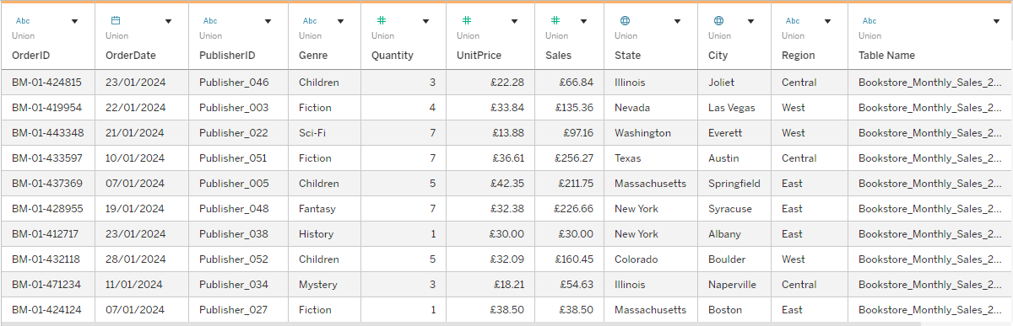
Dataset Overview
Source of Data:
1. Bookstore_Monthly_Sales_2024_01.csv
2. Bookstore_Monthly_Sales_2024_02.csv
3. Bookstore_Monthly_Sales_2024_03.csv
4. Bookstore_Sales.csv
5. Publisher_Info.csv
Description of Dataset Content:
Bookstore monthly sales union number of columns: 11
Bookstore_Sales.csv number of columns: 16
Publisher_Info.csv number of columns: 6
Total number of records: 750
Data sources joined on PublisherID
Union of 3 of the bookstore monthly sales to make Q1
Relevance of Dataset to Project Goals
Contains Quantity and Unit price to determine sale amount.
OrderDate to compare sales over a period of time.
Region to explore which areas are performing better than others.

Slide 4
Dataset Structure
The dataset contains the following key columns:
Categorical:
OrderID -> Individual ID of each order.
OrderDate -> The date an order was placed.
PublisherID -> The ID of the publisher of the book. Used to join the data sources together.
Genre -> Different genres of books.
State -> The state the book was purchased from.
City -> The city the book was purchased from.
Region -> The region the book was purchased from. (Central, East, South, West).
Numerical:
Quantity -> The amount of books purchased.
UnitPrice -> The price per unit (book).
Sales -> The total sale amount.

Slide 5
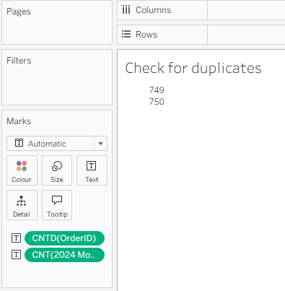
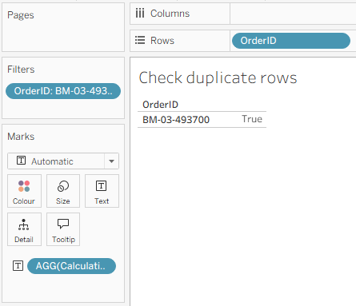
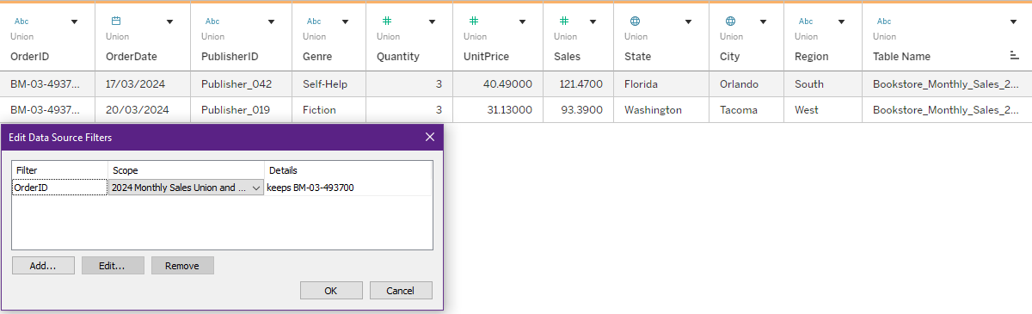

Identified Problems / Data Cleaning
Check for duplicates
of OrderID
The duplicated OrderID:
The duplicated row
in the dataset:
There is a data quality issue where there is a duplicated OrderID “BM-03-493700”.
In this instance I have left it as it is. If I were to change it, I would be creating an ID that never existed and it would go against best practise.
This issue implies that there lies an error in creating unique a OrderID for each order made.
There are no missing values in the data.
To check this I opened the data source tab and sorted each column from smallest to largest.
If there were missing values, it would’ve shown as an empty cell.

Slide 6
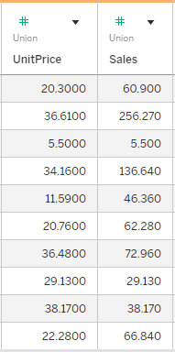
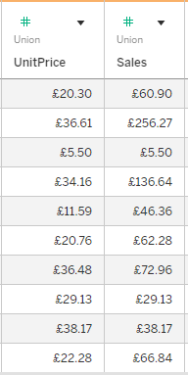


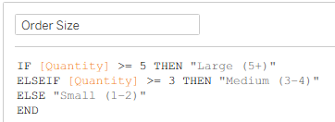
Data Transformation
Changed Formatting to Currency for UnitPrice and Sales Column
Avg. Sales Per Order
Avg. Unit Price (weighted)
Order Size

Slide 7
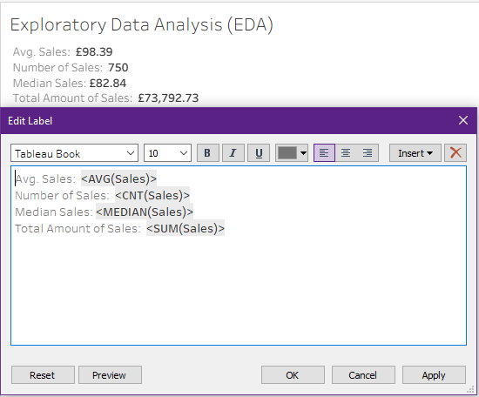
Data Exploration (EDA)
From this brief overview, we can see that:
The average sale amount is £98.39
The total number of orders placed for Q1 was 750
The typical sale value was £82.84
The total amount of sales for Q1 was £73,792.73

Slide 8
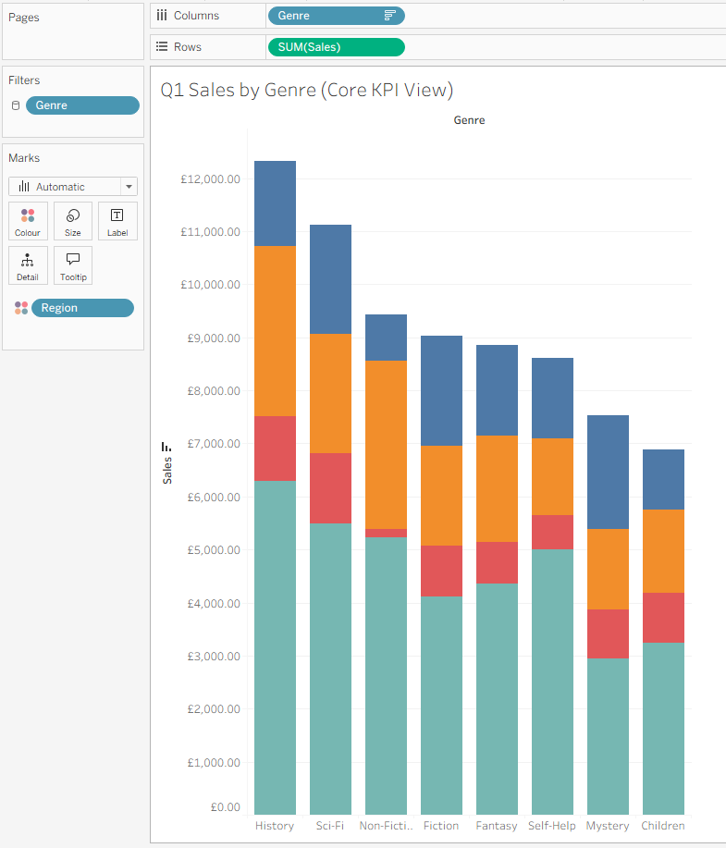
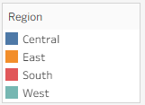
Visual Analysis
Q1 Sales by Genre (Core KPI View)
Goal: Identify which book genres generated the highest sales in Q1 2024
From the graph we can see that the history genre has the highest amount of sales in Q1 with £12,316.63
We can also see that children books performed the worst in sales with £6,886.85 in Q1
Despite history being the best selling genre overall, Sci-Fi sales (£2,065.03), Fiction sales (£2,071.33), Fantasy sales (£1,699.10) and Mystery sales (£2,139.91) overtake History sales (£1,598.50) in the Central region
This suggests that customer preferences in the Central region differ from the overall trend

Slide 9
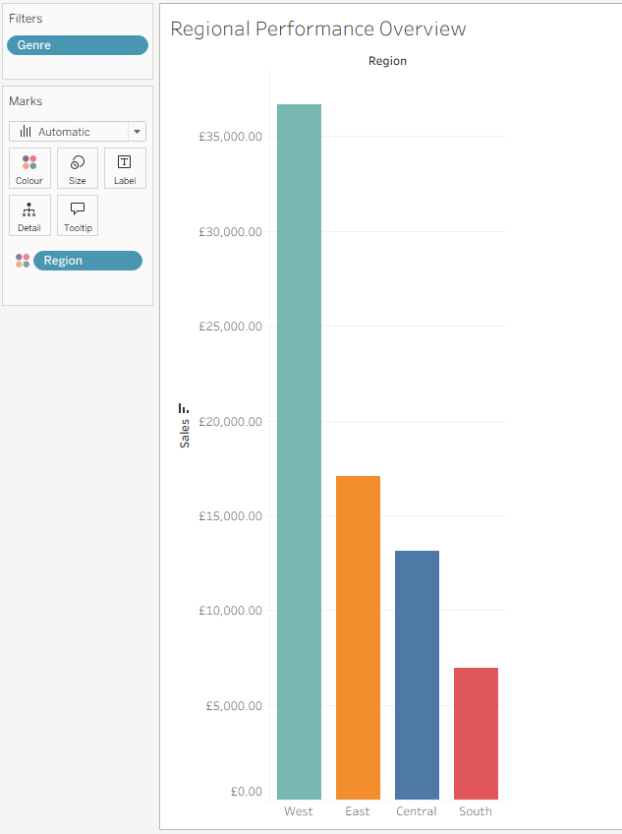
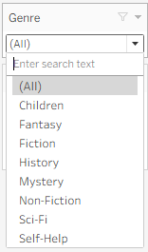
Visual Analysis
Regional Performance Overview
Goal: Compare sales performance across Regions to support Q2 regional targeting
We can see that the West region is the highest performing in sales.
It generates over double the amount of sales of the next best selling region – East (£36,666.66 VS £17,056.30).
By selecting each genre, we can see that the west region outperforms every other region in sales.
This could mean that there are more customers in the west region than other regions or that customers from the west region place multiple orders but we wouldn’t be able to determine this since we don’t have any customer data.

Slide 10
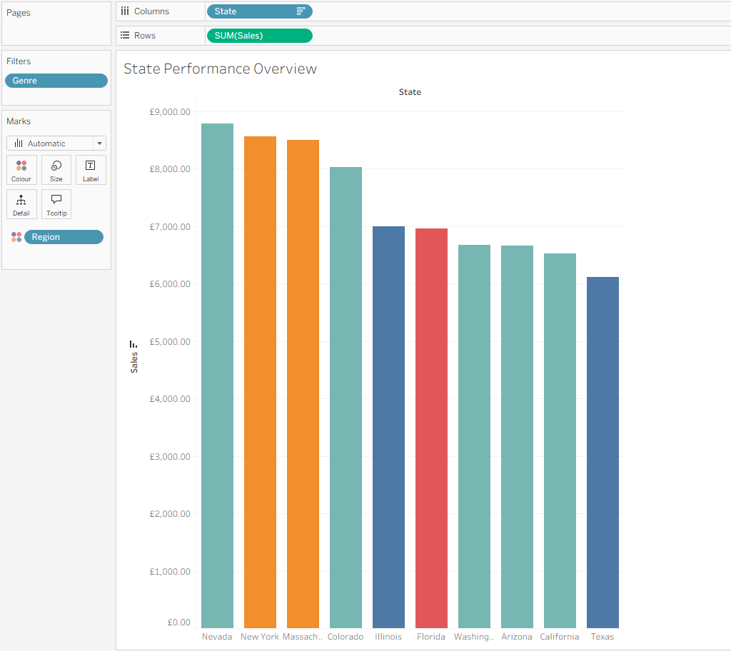
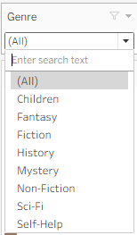
Visual Analysis
State Performance Overview
Goal: Compare sales performance across States to support Q2 State targeting.
We can see that Nevada is the highest performing state in sales, generating £8,781.48.
By breaking down the data into state and region, we can see that Florida is the only southern region.
This indicates why the South region accounts for a small amount of sales.
We can see that 5/10 states are in the west region, explaining the disparity in sales distributions between the regions and the fact that the west region had double the amount of sales than the East region

Slide 11
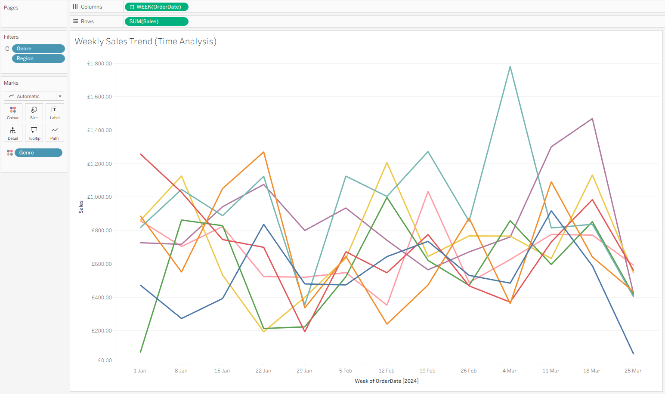
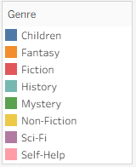
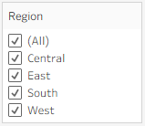
Visual Analysis
Weekly Sales Trend (Time Analysis)
Goal: Show how sales changed week by week during Q1 2024.
Weekly sales fluctuate across all genres.
There is no clear consistent upwards or downwards trend except with sales declining towards the 29th of January and the 25th of March.
Different genres peak at different times
This suggests that demand is not stable and it may be influenced by seasonal factors but we would need more data to be sure.

Slide 12
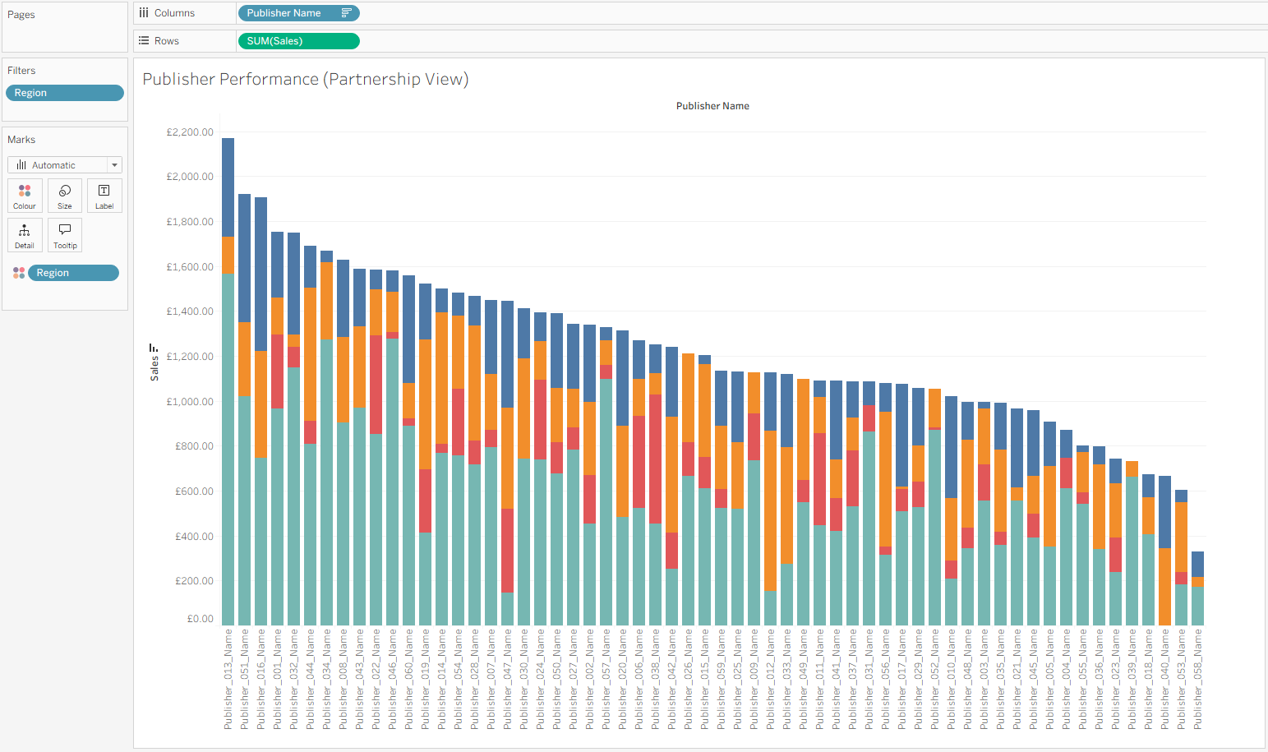
Visual Analysis
Publisher Performance (Partnership View)
Goal: Identify top and bottom performing publishers in Q1 2024.
From this graph, we can see which publishers perform better in different regions.
This information can be used to help region specific marketing, allowing the business to focus resources on areas where each publisher performs the strongest.
For example, Publisher_013, has the highest sales in the West region compared to other publishers but they have no sales in the South region so the business could consider increasing their presence in the south region to further improve sales.

Slide 13
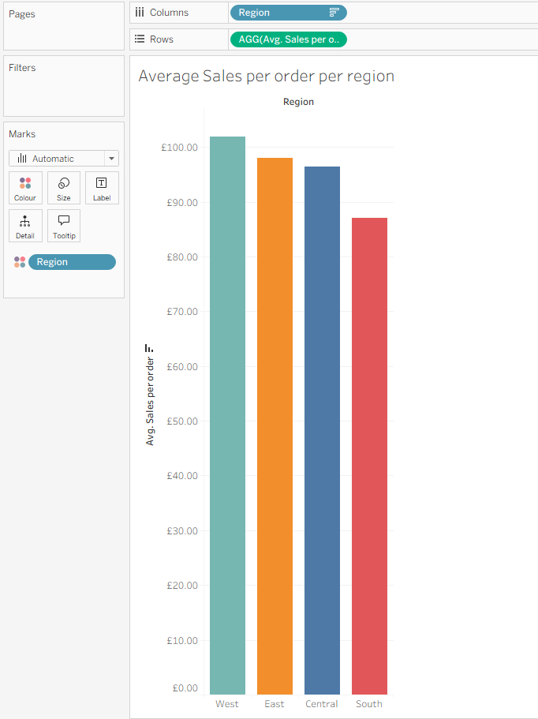
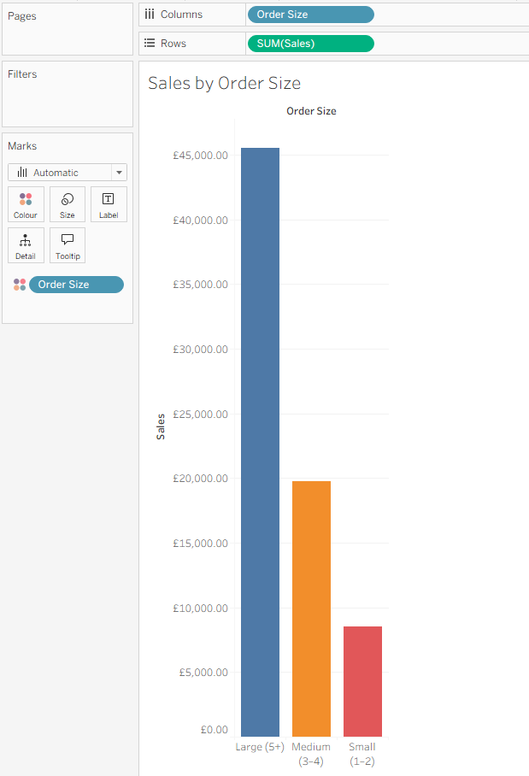

Visual Analysis
Create Key Calculated Fields
Average Sales per order per region
Sales by Order Size
The average sale amount per region is similar, having a range between the highest selling and lowest selling region of £14.82
This suggests that purchasing behaviour is relatively consistent across all regions, with customers spending a similar amount on each transaction.
Sales are heavily driven by large orders, accounting for more than double the revenue of medium orders.
This indicates that higher order sizes per transaction are a key contributor to overall revenue.

Slide 14
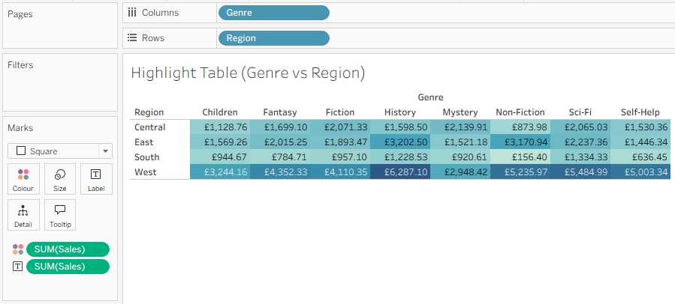

Visual Analysis
Highlight Table (Genre vs Region)
Goal: Spot strong/weak areas across the business quickly.
The Non-fiction genre in the southern region generates the least revenue with only £156.40 in sales.
History books in the West region generate the most revenue with £6,287.10 in sales.
Overall, the west region generates the most revenue.
The southern region generates the least revenue overall with only 1 category having over £1,000 in sales.
This makes the southern region the worst performing region and a key area that the business could improve upon.

Slide 15
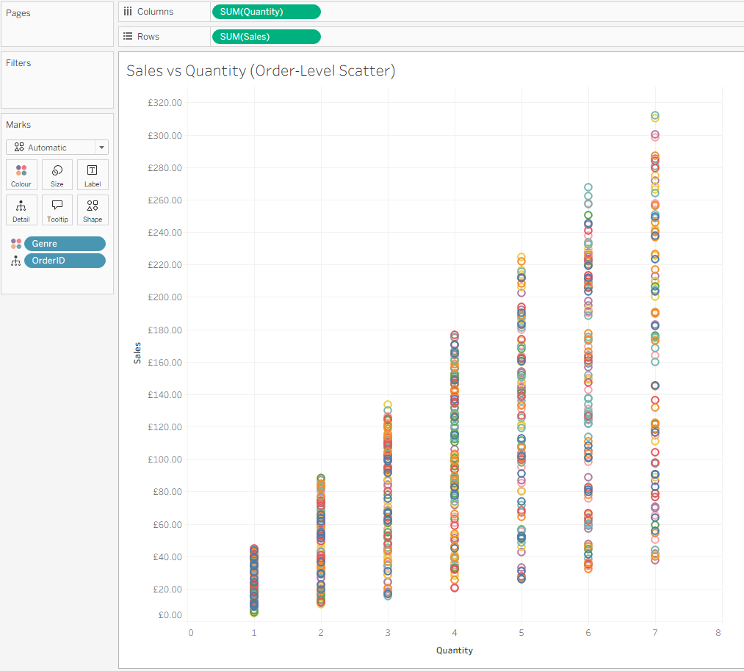
Visual Analysis
Sales vs Quantity (Order-Level Scatter)
Goal: Find high-quantity or high-sales outlier orders.
There is a positive relationship between the sales total and quantity of books purchased.
Whilst there is a positive correlation, there are some sales with high quantities that have low sale values.
For example, there are 27 orders where 7 books were bought and the total is under £100.00
This may suggest that there are some discounted or lower priced books.
There are also some high-value transactions, with 15 books sold for over £40 each whilst there are 85 orders where 2 or more books were purchased for under £40.
This indicates significant variation in pricing and with both premium priced and discounted products appearing within the dataset which may impact overall revenue patterns

Slide 16
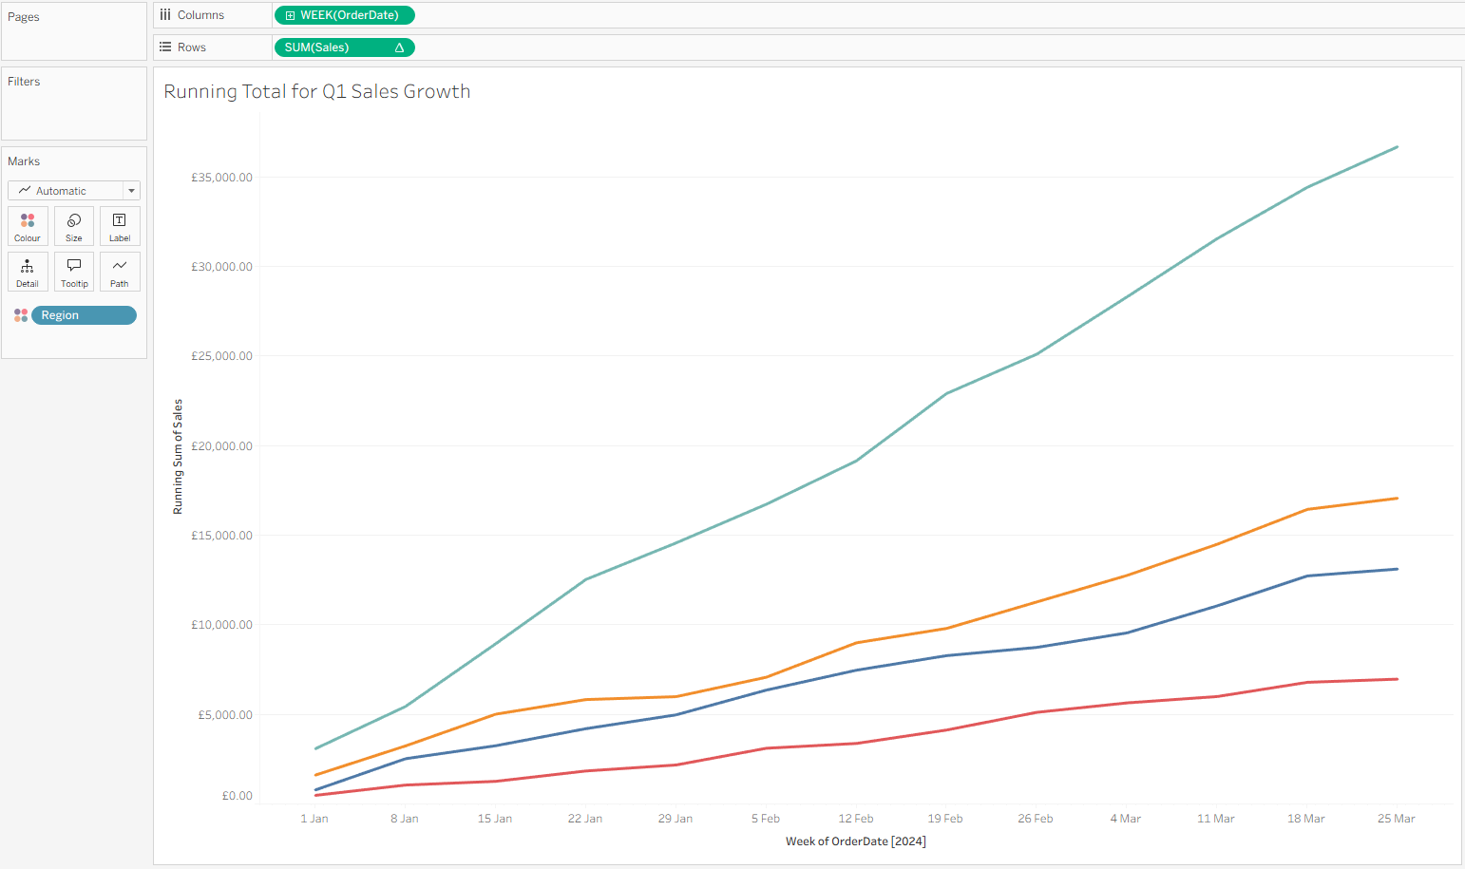
Visual Analysis
Running Total for Q1 Sales Growth
Goal: Show how Q1 sales accumulated over time to support Q2 targets.
The west region has the highest sales growth compared to the other regions.
In contrast, the South region shows the weakest growth, having minimal increase in cumulative sales over time.
Notably, the second least performing region (Central) reached £10,000 in sales in the period between 4th-11th march, while the Southern region ended Q1 at £6,962.80.
This suggests that the West region is a key driver of revenue growth heading into Q2, while the South region may require targeted strategies to improve performance and meet future sales targets.

Slide 17
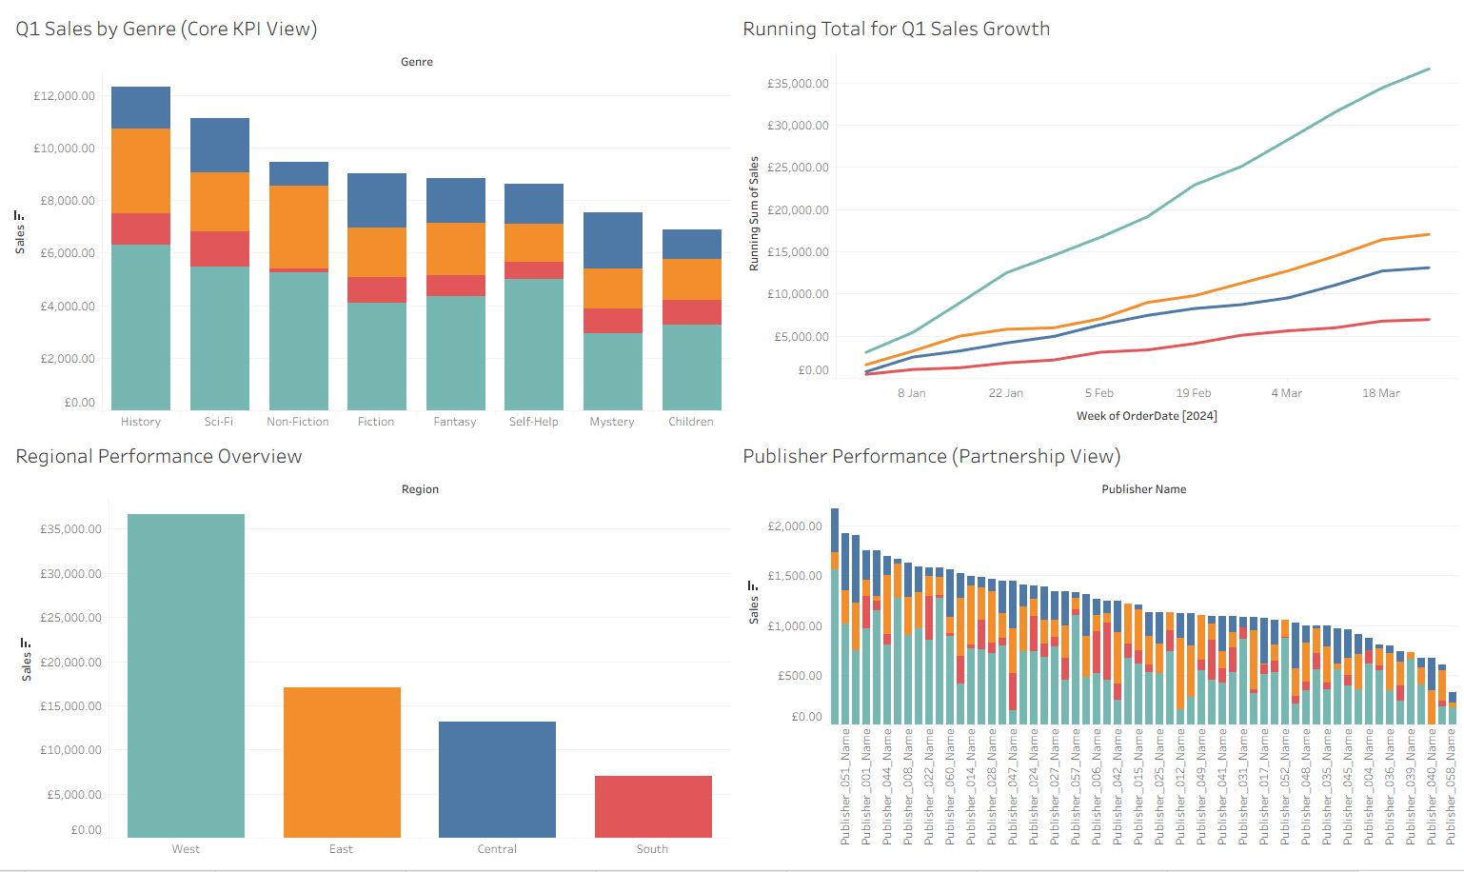
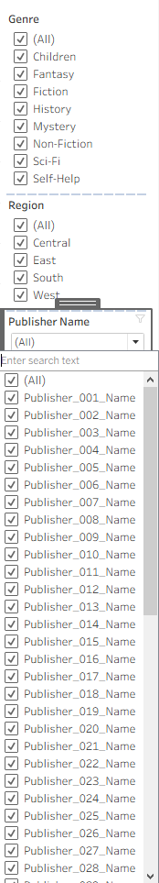
Visual Analysis
Final Executive Dashboard
Goal: Present Q1 2024 Bookstore Performance in one view for management.

Slide 18
Key Insights
We found that the West region brings the most revenue; generating over £36.6k, which is more than double the East (£17.0k). This makes the west region the primary driver of performance.
The South region is underperforming significantly; ending Q1 at just £6,962. It also has the least sales growth over time.
Regional preferences differ; with genres such as Sci-Fi, Fiction, and Mystery outperforming History in the Central Region despite History leading overall (£12.3k).
Large orders drive revenue; contributing over double the sales of medium-sized orders, highlighting the importance of order amount.
Sales fluctuate week-to-week; with no consistent trend. This indicates unstable or seasonal demand patterns.
Pricing varies significantly; with examples of 7-item orders under £100 alongside high-value transactions exceeding £40 per book.
Revenue is not only influenced by the number of transactions but also by purchasing behaviour, particularly by order size and pricing variation.

Slide 19
Business Recommendations for Q2
Practical suggestions linked to analysis
Implement customer data collection. Customer data needs to be analysed to identify repeat customers, high value customers and introduce retention.
The business should:
- Develop a loyalty program to connect orders to a customer to track customer buying behaviour.
- Offer personalised offers and loyalty incentives to reduce weekly sales fluctuations.
- Promote other book genres through the program to increase cross selling opportunities.
Prioritise marketing investment in the west region. The west region is the highest generator for revenue in the business.
The business should:
- Focus on continuing to invest and grow the already high-performing market.
- Increase marketing spend to maximise return on an established customer base.
- Strengthen customer retention to maintain long term revenue stability.
Develop targeted recovery strategies for the south region. Despite being the smallest region with having stores in only 1/10 states, it has the lowest cumulative performance.
The business should:
- Focus marketing and purchasing in southern region for Q2
- Implement region specific discounts to encourage high quantity purchases from existing customers.
- Improve product visibility to attract new customers.
- Implement targeted local promotional campaigns to encourage more reading in the area.

Slide 20
Closing and Reflection
Limitations and reflection question
Limitations:
Reflection Questions:
Visualisation: which visualisation was most effective in communicating your insights?
The running total for sales growth visualisation was the most effective as it displays the cumulative sales for each region over time.
It highlights overall performance rather than focusing on fluctuations in sales and sets aside factors such as number of stores per region.
From the graph, it is clear that the South region consistently underperforms compared to other regions, suggesting that it is a priority area for increased marketing and purchasing focus in Q2.
Data Quality: What data quality issues did you encounter and how did you handle them?
There was a duplicated orderID, however there was different row data (order date, quantity, sales, state, etc). I ignored it as there is valid data and it is only a mistake in the ID. Changing the orderID would comprimise data integrity and is bad practise.
Lack of customer-level data:
A key limitation is that we don’t have information such as customerID. With that we could track repeat customers, total purchases, loyalty behaviour etc.
Due to this the analysis is limited to transactional level insights only.
Lack of customer-level data:
The dataset does not include external factors such as marketing spend, promotions, economic conditions, or competitor activity.
This means conclusions about why certain regions or genres perform better are based on assumptions rather than confirmed causes.

